Slide 1
Refraction of Light Through a Concave Lens

Slide 2

When you have completed this lesson you should be able to:
Understand the behaviour of three principal rays drawn when creating a ray diagram.
Draw ray diagrams for the refraction of an object through a concave lens.
Describe the nature of the image produced by a concave lens given the location of the object.

Slide 3
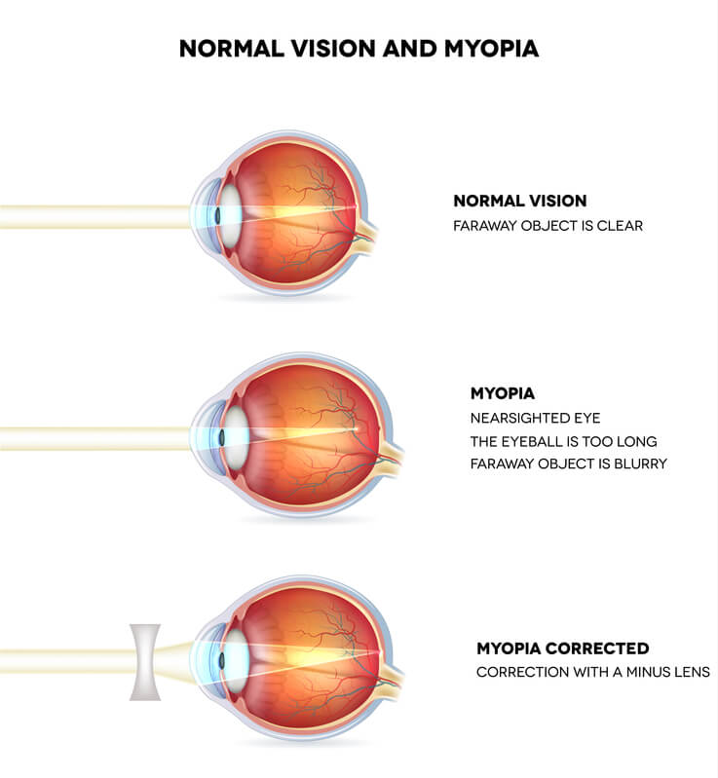
There are many uses of concave lenses in everyday life.
The most common example of lenses that we see and use on a day to day basis are the lenses placed in glasses.
If you suffer from short-sightedness or myopia (meaning you are unable to focus on far away objects), then light entering your eye will focus in front of your retina. This could be due to a long eyeball or an inability of the lens in your eye to focus correctly. Short-sightedness is corrected by using glasses that contain concave lenses, which focus the light on your retina, resulting in sharp images being formed.

Slide 4
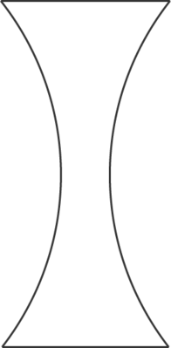

What is a concave lens?
A lens is made from transparent material, which light can pass through. A lens can be shaped so that the light passing through it will bend in a particular way.
A concave lens is a piece of transparent material that is thicker at the edges than it is in the middle. It can be identified as a lens that curves inwards in the middle, much like an hourglass.

Slide 5
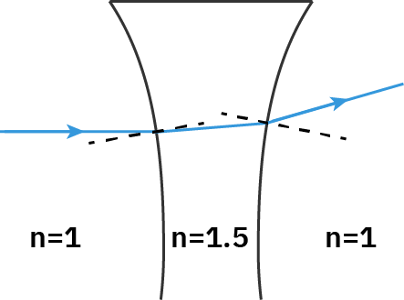
Why does light bend as it passes through a lens?
We know that light bends or refracts as it passes between two mediums that have different indices of refraction. Most lenses are made from plastic or glass which have higher indices of refraction than air.
As light enters the lens it goes into a region with a higher refractive index and therefore bends towards the normal. Similarly, as light leaves the lens it goes into a region with a lower refractive index and bends away from the normal. If we consider the light ray before it entered the lens and the light ray after it exits the lens, we can see it is travelling in a different direction and has therefore undergone refraction from the lens.

Slide 6
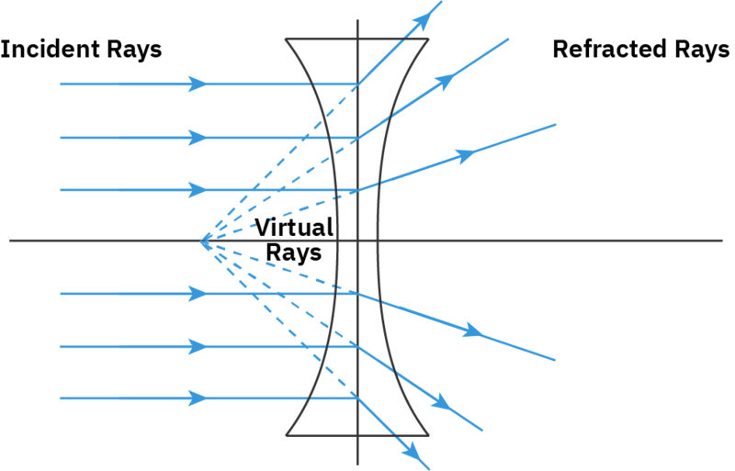
A concave lens is a type of diverging lens.
This means light rays coming from a distant source (which are considered to be parallel to each other) enter the lens and get refracted outwards. These refracted rays all spread away (diverge) from each other on the other side of the lens.
We can trace these refracted rays in front of the lens, to show them all converging on one spot. This shows where the refracted light rays appear to have come from.
When we trace light rays in front of a lens, we draw them as dotted lines. This helps us identify them as virtual light rays (as they cannot travel in front of the lens in reality).

Slide 7
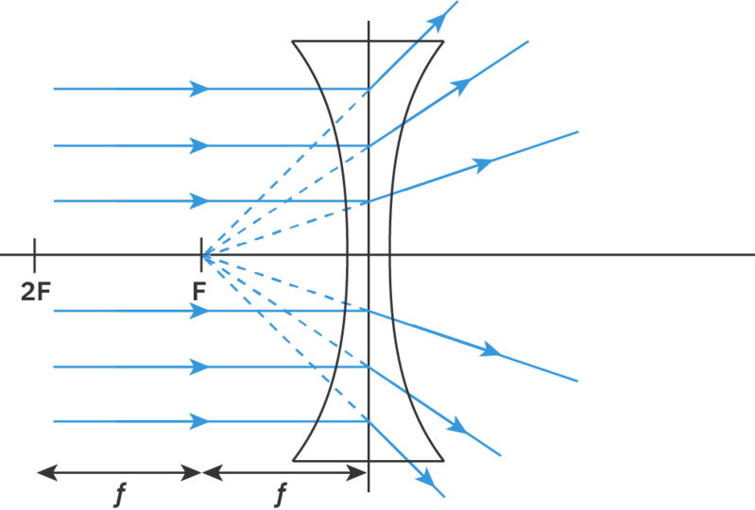
The spot where all of the refracted light rays converge is called the focus of a lens.
The focus of a concave lens is located in front of the lens (on the same side as the incident light) and is found by using virtual light rays. For this reason, we often call the focus point on the same side of the lens as the incident light the virtual focus, which is denoted by F.
The distance between the focus and the edge of the lens is referred to as the focal length, f. Twice the focus of a lens, denoted by 2F, is also included in lens diagrams. This point is located two focal lengths away from the lens.

Slide 8
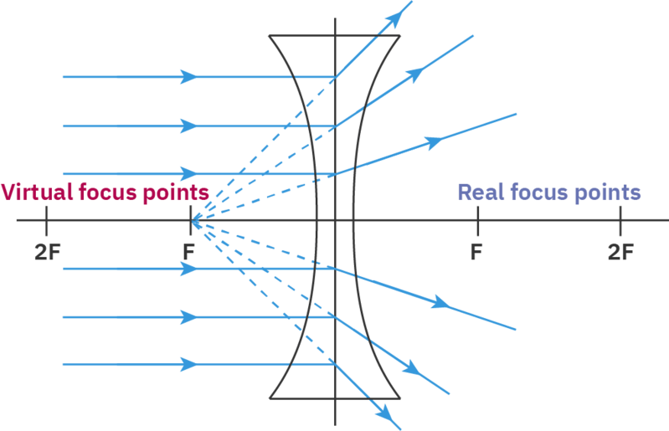
Light can pass through either side of a lens.
If light is incident on the lens from the left, then the virtual rays will converge at a virtual focus on the left. If light is incident from the right then the virtual rays will converge at a virtual focus on the right. This means every lens will have two focus points and we need to use each of these when creating ray diagrams.
To simplify this process we will label the focus which is on the same side as the incident light the virtual focus, and the focus which is on the same side as the refracted light the real focus.

Slide 9
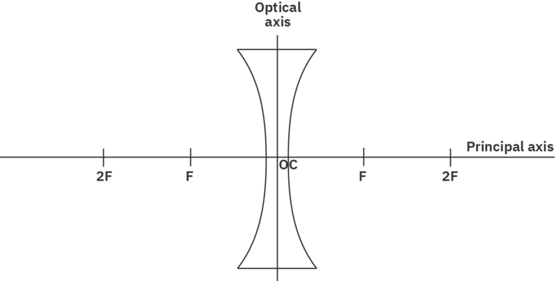
A ray diagram is a drawing which can be used to describe the image formed by a concave lens.
To draw a ray diagram we first need to draw some axes. The first of these is called the principal axis and consists of a horizontal line. The second axis is called the optical axis and it approximates the concave lens as a vertical straight line. The optical axis is placed in the middle of the principal axis and all refraction occurs along this line.
The intersection between the principal and optical axes is referred to as the optical centre of the lens, denoted in the diagram by OC. Both of the focus points and twice the distance of the focus points are also included along the principal axis. The horizontal and vertical scales of ray diagrams do not have to be the same. In fact, the vertical scale is often much more magnified than the horizontal scale, so that the diagram is easier to draw.

Slide 10
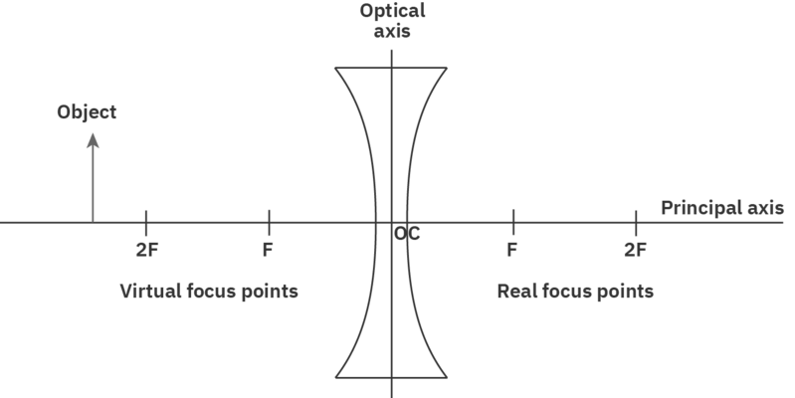
Once we have the axes of a ray diagram set up we can add the object and start to determine its refracted image.
The object is generally placed to the left of the optical axis and is represented by a vertical arrow, pointing upwards. This will make it much easier to determine the nature of the image.
The object is usually placed in relation to the properties of the lens. For our first example, we will place the object outside (to the left of) twice the virtual focus of the concave lens. Note the virtual focus is located on the same side of the lens as the object.

Slide 11
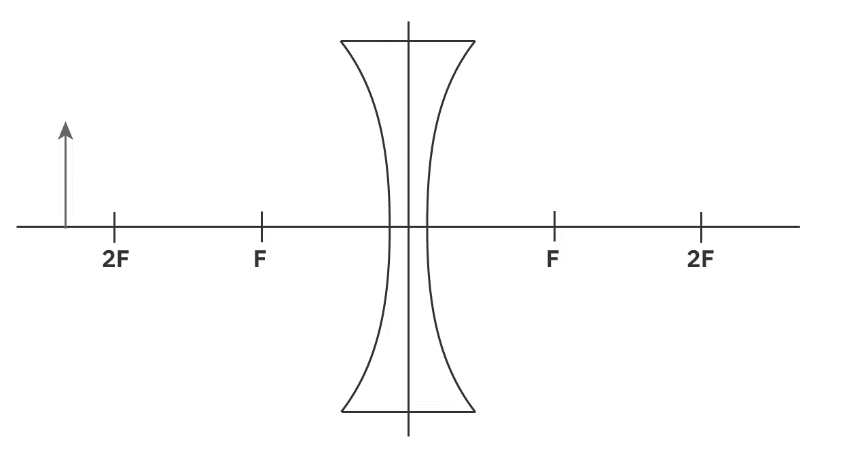
Now that we have set up our ray diagram, we can use three principal rays to determine the position of the image produced by a concave lens.
The first principal ray we consider will start at the top of the object. It will then travel parallel to the principal axis until it reaches the optical axis (the lens). As it refracts from the lens it will appear as though it has travelled from the virtual focus in front of the lens (where all the refracted rays of incident parallel rays will converge) and continue on beyond the ray diagram.
When drawing this principal ray on a ray diagram we need to ensure that the section of the refracted ray that is in front of the lens (from the virtual focus to the edge of the lens) is drawn with a dotted line while all other rays are drawn as solid lines.

Slide 12

The second principal ray we will consider is the reverse process of the first principal ray.
The second principal ray will also start at the top of the object. It will travel to the lens towards the real focus behind the lens. However, once it reaches the lens it will get refracted from the lens and travel parallel to the principal axis.
Drawing this principal ray, we place our ruler joining the top of the object to the real focus behind the lens. However, our incident ray is only drawn up to the lens. The refracted ray is then drawn parallel to the principal axis.

Slide 13

The third principal ray we will consider is unaffected by the lens.
The third principal ray starts at the top of the object (the same as the two previous rays). It then travels from the top of the object to the optical centre of the lens. It will pass through the optical centre of the lens along the same path, without undergoing any refraction.

Slide 14

To determine the location of the image we need to combine three principal rays onto one diagram.
As we draw on three principal rays (always starting from the top of the object) we notice that there is no point at which all three refracted rays converge. This indicates that we cannot form a real image with a concave lens. However, we can create a virtual image.
A virtual image is formed from virtual light rays and will not be able to be seen on a screen. We will only be able to observe a virtual image when we look through the lens and it will appear to be placed in front of the lens.

Slide 15
To locate a virtual image, we backtrace the refracted principal rays.
This means we find the location where the refracted principal rays meet the concave lens and trace them back in front of the lens, making sure to keep the same angles for our lines. When we trace rays in front of a lens, creating virtual rays, it is referred to as backtracing and the rays are drawn using dotted lines. Only one of the principal rays need to be backtraced as the other two have already been backtraced.
Although the principal ray going through the optical centre of the lens has not technically been backtraced, the ray is unaffected by refraction. This means the backtraced ray will be in the same location as the incident ray, making its inclusion in our ray diagram redundant.
There is a point in front of the lens where the three backtraced rays (virtual rays) converge. This point of intersection identifies the top of the virtual image. We can draw a vertical line from this location back to the principal axis to show the formation of the virtual image. This image has formed between the edge of the lens and its virtual focus.

Slide 16
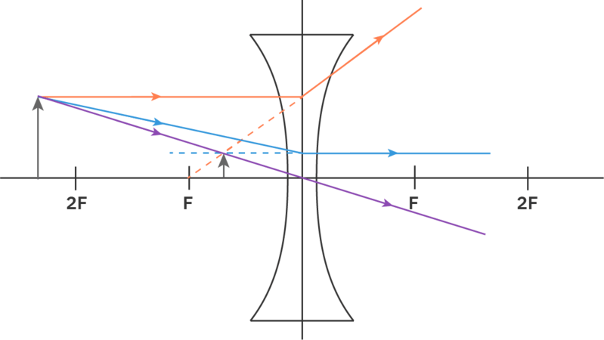
It is not enough just to show the location of the image on a ray diagram. Often we also need to describe the nature of the image, consisting of three different properties.
In the ray diagram below, we can see that the image has the same orientation as the object, as both arrows point upwards. We refer to this as an upright image. The image has been formed by virtual light rays and is therefore referred to as a virtual image. It turns out virtual images are always upright and upright images are always virtual.
Lastly the image in the ray diagram below is smaller than the object. This is referred to as a diminished image. Thus, the nature of this image is virtual, upright and diminished.

Slide 17
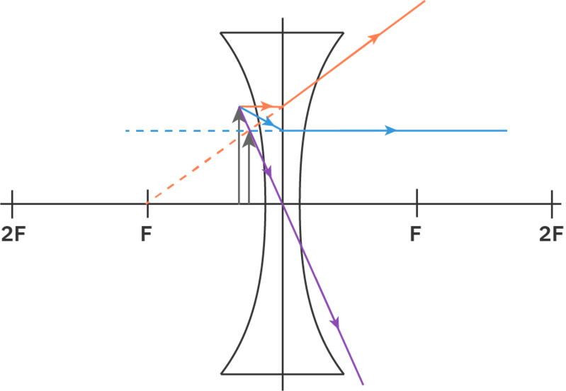
A concave lens always creates a virtual, upright and diminished image.
Regardless of the object location with respect to a concave lens a virtual, upright and diminished image is always formed between the edge of the lens and its virtual focus.
Although the image remains diminished, as we move the object closer to the lens the size of the image increases. In the ray diagram below, we have placed the object very close to the lens and the image (located in front of the object) is almost the same height as the object.

